Slide 1
THE VENTRICULAR
SYSTEM
DR OMOTAYO H A

Slide 2
OUTLINE
Development
Ventricles
  Anatomy, boundaries and foramnia
Ependyma
  Ependymoma
Choroid plexus
  Tumors, CSF production & circulation
Hydocephalus
  Variants

Slide 3
INTRO
By about the third week of development, the nervous system consists of a tube closed at both ends
In its cavity is the neural canal that gives rise to the ventricles of the adult brain and the central canal of the spinal cord.
The choroid plexus, which secretes the CSF that fills the ventricles and the subarachnoid space, arises from tufts of cells that appear in the wall of each ventricle during the first trimester.

Slide 4
DEVELOPMENT

Slide 5
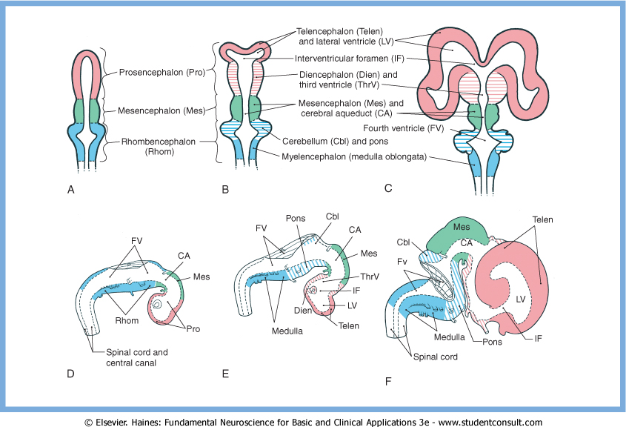

Slide 6
DEVELOPMENT
The shape of the ventricular system conforms, in general, to the changes in configuration of the surrounding parts of the brain. The lateral ventricles follow the enlarging cerebral hemispheres, and the third ventricle remains a single midline space.
The communications between the lateral ventricles and the third ventricle, the interventricular foramina (of Monro), are initially large but become small, in proportion to the enlarging brain, as development progresses

Slide 7
DEVELOPMENT
Proliferation of the neural elements of the mesencephalon results in a reduction in the size of the cavity of this vesicle to form the cerebral aqueduct
This creates a constricted region in the ventricular system and thus a point at which the flow of CSF may be easily blocked.
Occlusion of the cerebral aqueduct during development may be the result of gliosis due to infection or a consequence of developmental defects of the forebrain, a rupture of the amnionic sac in utero, or forking of the aqueduct( genetic sex-linked ).
Occlusion of the cerebral aqueduct results in a lack of communication between the third and fourth ventricles and blocks the egress of CSF from the third ventricle.

Slide 9
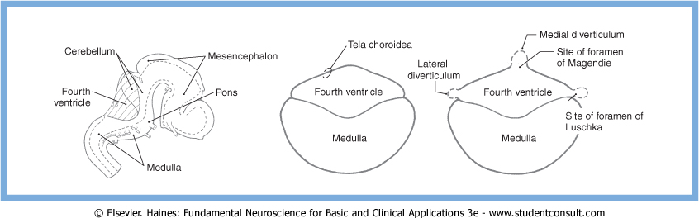
DEVELOPMENT (4TH VENT)
Vent & central canal 1st form a closed system. In the second and third months of development, three openings form in the roof of the fourth ventricle, rendering the ventricular system continuous with the subarachnoid space
The caudal part of the roof of the fourth ventricle consists of a layer of ependymal cells internally and a delicate layer of connective tissue externally
Small bulges in the caudal roof appear at the lateral extremes of the fourth ventricle thining the membrane and and breaking it down.
The resultant openings are the medial foramen of Magendie and the lateral foramina of Luschka

Slide 10
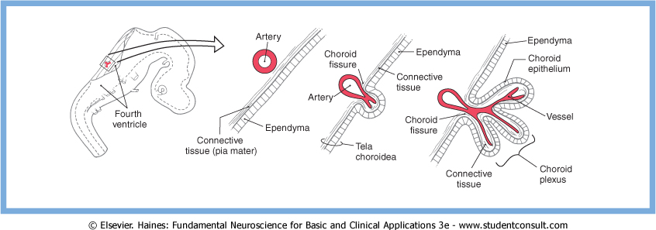
DEVELOPMENT (CH. PLEXUS)
Developing arteries in the immediate vicinity invaginate the roof of the ventricle to form a narrow groove, the choroid fissure, in the tela choroidea.
The involuted ependymal cells, along with vessels and a small amount of connective tissue, represent the primordial choroid plexus inside the ventricular space.
As development progresses, the choroid plexus enlarges, forms many small elevations called villi, and begins to secrete CSF

Slide 11
DEVELOPMENT
By about the end of the first trimester, the choroid plexus is functional, the openings in the fourth ventricle are patent, and there is circulation of CSF through the ventricular system and into the subarachnoid space.

Slide 12
Ventricles
  Anatomy, boundaries and foramnia

Slide 13
LATERAL VENTRICLES
As the hemispheres develop they create the flattened "C" with a short tail shape of the lateral ventricles that is present by birth .
The lateral ventricle consists of an anterior horn, a body, and posterior and inferior horns

Slide 14
LATERAL VENTRICLES
The junction of the body with the posterior and inferior horns constitutes the atrium of the lateral ventricle.
The glomus (a large clump of choroid plexus) is found in the atrium
In adults and especially in elderly persons, the glomus may contain calcifications that are visible on CT scans
Shifts in the position of the glomus, usually accompanied by alterations in the volume or shape of the surrounding ventricle, may indicate some type of ongoing pathologic process or space-occupying lesion.

Slide 15
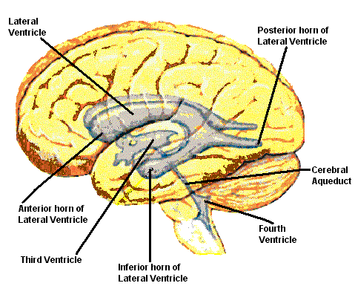
LATERAL VENTRICLES
The anterior horn and body of the lateral ventricle are bordered:
Medially: by the septum pellucidum (at rostral levels) and the fornix (at caudal levels)
Posteriorly: (superiorly) by the corpus callosum

Slide 16
LATERAL VENTRICLES
The floor of the body of the lateral ventricle is made up of the thalamus
The lateral wall contains the caudate nucleus throughout its extent
The medial wall have the hippocampal formation in it
The rostral end have a large group of cells (the amygdaloid complex) in it.

Slide 17
LATERAL VENTRICLES
The inter-ventricular foramina of Monro are located between the column of the fornix and the rostral and medial end of the thalamus.
There are two interventricular foramina, one opening from each lateral ventricle into the single midline third ventricle

Slide 18
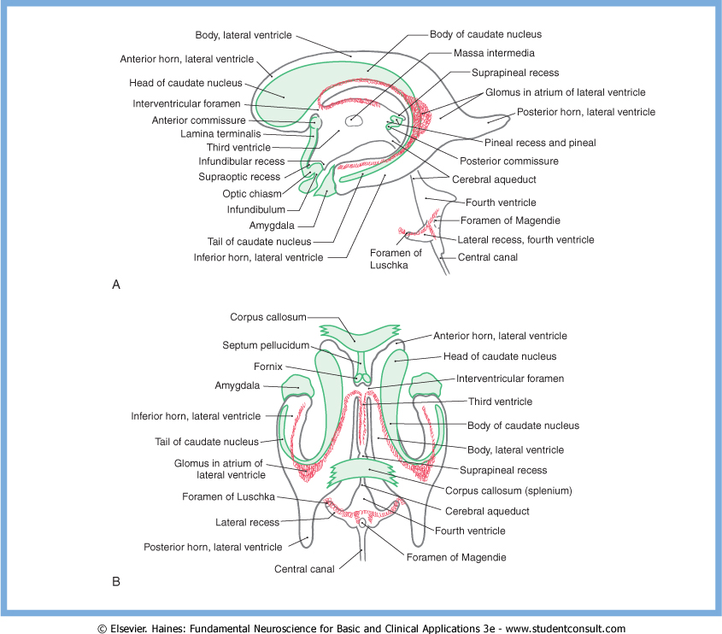

Slide 19
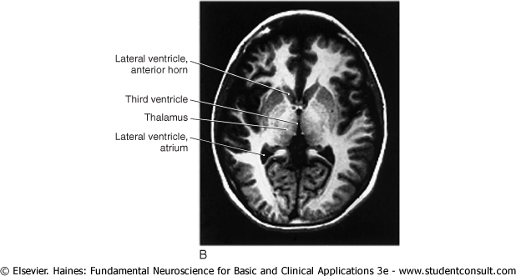
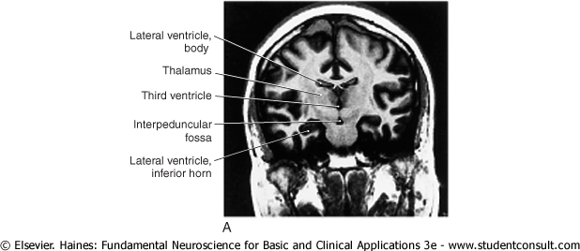
THIRD VENTRICLE
The third ventricle, the cavity of the diencephalon, is a narrow, vertically oriented midline space that communicates rostrally with the lateral ventricles and caudally with the cerebral aqueduct
The third ventricle has an elaborate profile on a sagittal view & is quite narrow in the coronal and axial planes

Slide 20
THIRD VENTRICLE
The boundaries of the third ventricle are formed by the dorsal thalamus and hypothalamus, and recesses (supraoptic, infundibular, pineal, suprapineal).
The rostral wall of the third ventricle is formed by a short segment of the anterior commissure and a thin membrane, the lamina terminalis,
The floor of the third ventricle is formed by the optic chiasm and infundibulum and their corresponding recesses, plus a line extending caudally along the rostral aspect of the midbrain to the cerebral aqueduct.
The caudal wall is formed by the posterior commissure and the recesses related to the pineal, whereas the roof is the tela choroidea, from which the choroid plexus is suspended

Slide 21
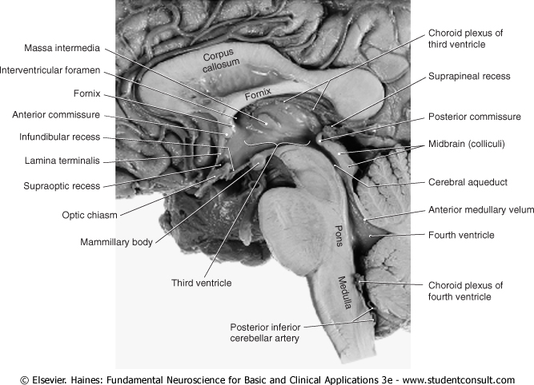

Slide 22
CEREBRAL AQUEDUCT
The cerebral aqueduct communicates rostrally with the third ventricle and caudally with the fourth ventricle
This midline channel is about 1.5 mm in diameter in adults and contains no choroid plexus.
Its susceptible to occlusion (triventricular hydrocephalus). For example, cellular debris in the ventricular system (from infections or hemorrhage) may clog the aqueduct. Tumors in the area of the midbrain (such as pinealoma) may compress the midbrain and occlude the aqueduct.
The cerebral aqueduct is surrounded on all sides by a sleeve of gray matter that contains primarily small neurons; this is the periaqueductal gray or central gray.

Slide 23
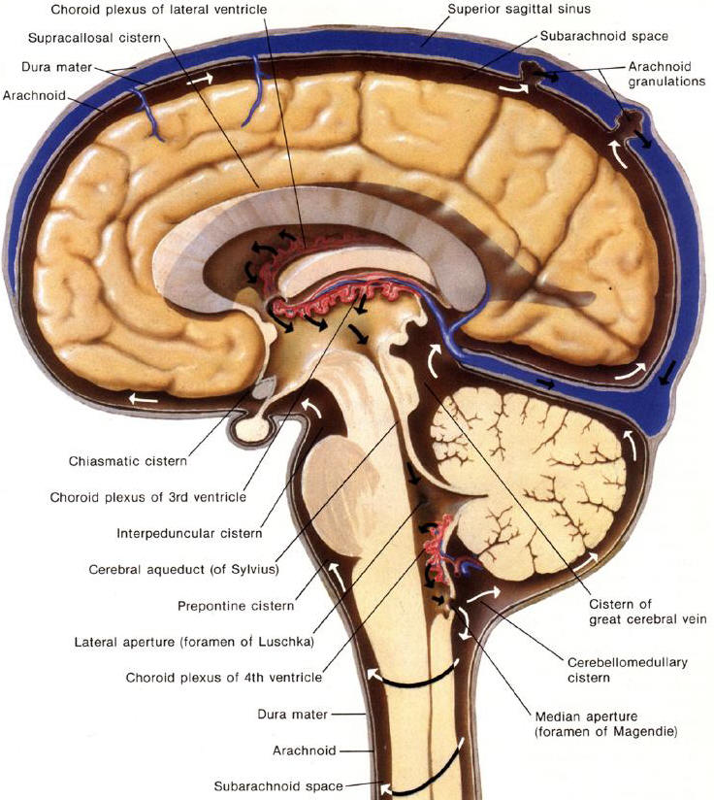

Slide 24
FOURTH VENTRICLE
The roof of the caudal part of the fourth ventricle and the lateral recesses is composed of tela choroidea
The rostral boundaries of this space are formed by cerebellum and the superior cerebellar peduncles and anterior medullary velum
The floor of the fourth ventricle, the rhomboid fossa is formed by the pons and medulla

Slide 25
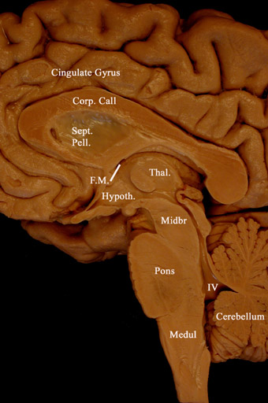

Slide 26
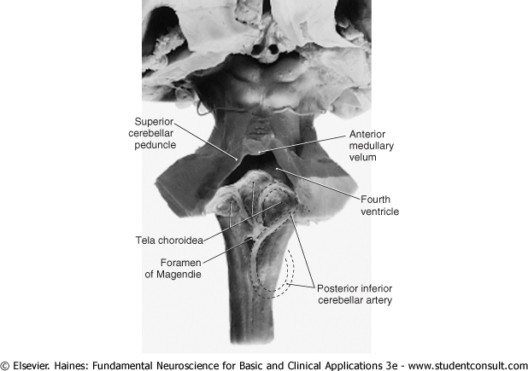

Slide 27
FOURTH VENTRICLE
The only openings between the ventricles of the brain and the subarachnoid space surrounding the brain are the foramina of Luschka and Magendie in the fourth ventricle.
It opens into the area of the pons-medulla-cerebellum junction, the cerebellopontine angle, through the foramina of Luschka
The irregularly shaped foramen of Magendie is located in the caudal sloping roof of the ventricle

Slide 29
HEMORRHAGE INTO THE VENTRICLES
A variety of events may result in blood accumulating in the ventricular spaces in the brain such as cerebral hemorrhage, rupture of an intracranial aneurysm (especially those located immediately adjacent to the third or fourth ventricles), or severe head trauma.
Less frequent causes are rupture, or bleeding, from an intraventricular AVM, or bleeding from a tumor located in, or invading, the ventricular space.

Slide 30
HEMORRHAGE INTO THE VENTRICLES
Whatever the cause, blood in the ventricles, especially acute blood, is clearly seen on CT The white appearance of the blood characteristically outlines the ventricular spaces and is clearly distinguishable from blood at other intracranial locations.
In fact, blood in the ventricular spaces can create an in vivo cast showing details of the ventricular spaces and their relationships
Alterations of size, shape, or position of a ventricle containing blood may be indicative of further neurologic complications

Slide 31
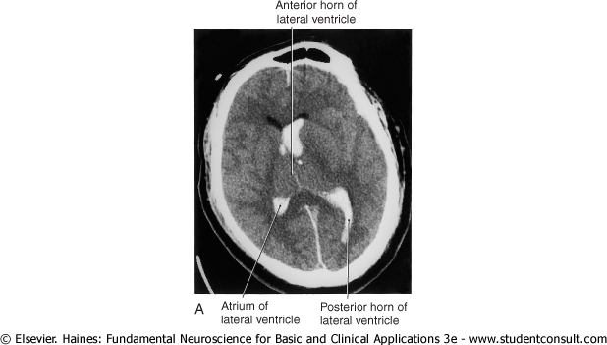
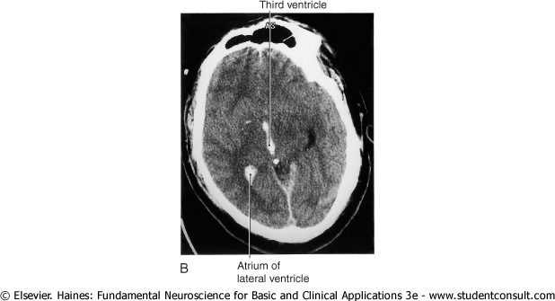
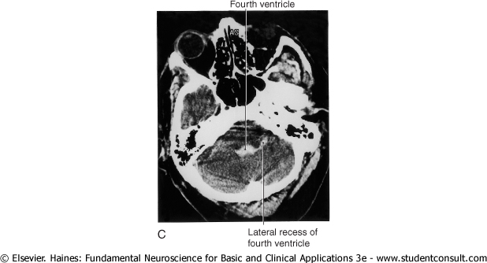

Slide 32
Ependyma
  Ependymoma

Slide 33
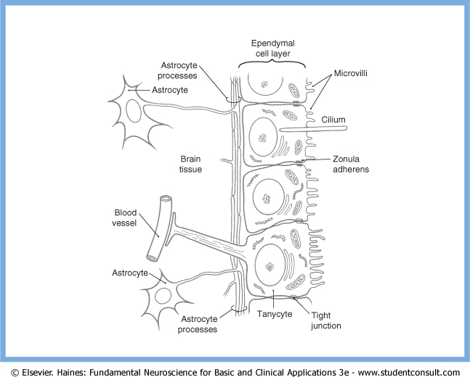
EPENDYMA
The ventricles of the brain and the central canal of the spinal cord are lined by a simple cuboidal epithelium, the ependyma.
Ependymal cells contain abundant mitochondria and are metabolically active.
Their luminal surfaces are ciliated and have microvilli, and the bases contact the subependymal layer of astrocytic processes.

Slide 34
EPENDYMA
There is not a continuous basal lamina between ependymal cells and the subjacent glial cell processes
Ependymal cells are attached to each other by zonulae adherens (desmosomes).
Tanycytes(3rd Vent) have basal processes that extend through the layer of astrocytic processes to form end-feet on blood vessels. They may function to transport substances between the ventricles and the blood and attached to each other by tight junctions. Desmosomes are also present between tanycytes.

Slide 35

EPENDYMOMA
Ependymomasconstitutes 5% to 6% of all glial cell neoplasms,
60% to 75% are located in the spaces of the posterior fossa, may also be found within the spinal cord or in the region of the cauda equina.
Seen most frequently in children younger than 5 years of age.
Lesions in supratentorial locations may produce signs and symptoms reflecting their location, for example, hydrocephalus in the case of blocked CSF flow or seizure activity.
Lesions in infratentorial locations frequently cause nausea and vomiting, headache, other signs and symptoms related to hydrocephalus, and cranial nerve signs and symptoms indicative of compression of, or tumor infiltration into, the brainstem

Slide 36
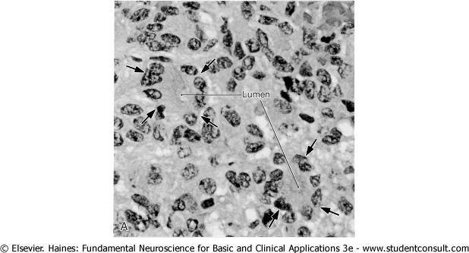
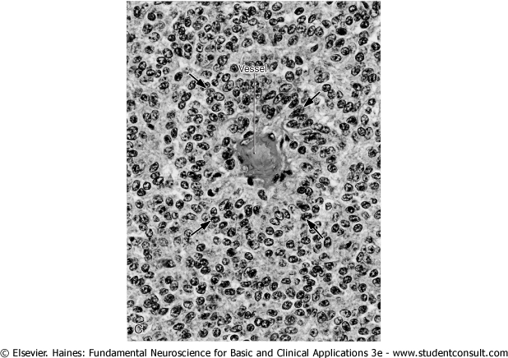
EPENDYMOMAS
The histologic appearance of ependymomas may vary, even from place to place within the same tumor.
These tumors are characterized by clusters of various sizes that are composed of polygonal or columnar cells arranged in a circle facing a lumen (true rosettes) or a small blood vessel (perivascular or pseudorosettes

Slide 37
Choroid plexus
  Tumors, CSF production & circulation

Slide 38
CHOROID PLEXUS
The choroid plexus in each ventricle is thrown into a series of folds called villi These are covered on their ventricular (luminal) surfaces by a continuum of dome-shaped structures, each with numerous microvilli.
Each villus consists of a core of highly vascularized connective tissue derived from the pia mater and a simple cuboidal covering (the choroid epithelial cell layer), which is derived from ependymal cells.

Slide 39
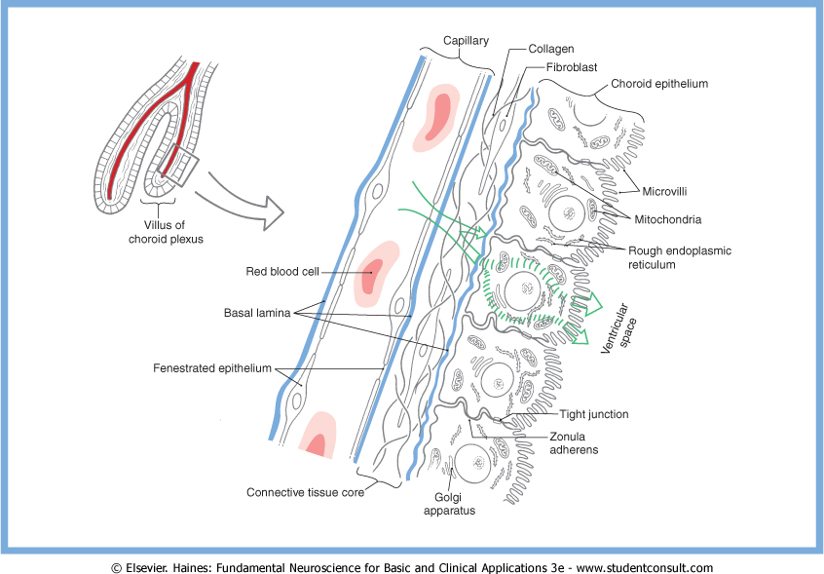
CHOROID PLEXUS
The abundant capillaries in the connective tissue core of each villus are surrounded by a basal lamina
The endothelial cells of these capillaries have numerous fenestrations, which allow a free exchange of molecules between blood plasma and the extracellular fluid in the connective tissue core (consists of fibroblasts and collagen fibrils).
Another basal lamina is formed at the interface between the connective tissue core and the choroid epithelial cells that form the surface of each villus
Choroid epithelial cells contain a nucleus, numerous mitochondria, rough endoplasmic reticulum, and a small Golgi apparatus . Thus, they are specialized to control the flow of ions and metabolites into the CSF.

Slide 40
CHOROID PLEXUS
Choroidal epi cell is attached to its neighbor by continuous tight junctions (zonulae occludentes) that seal off the subjacent extracellular space from the ventricular space.This represents the blood-CSF barrier
Ependymal cells are not tightly joined. Therefore, fluid exchange occurs freely between CSF and the extracellular fluid of the brain parenchyma. The composition of CSF can thus sometimes reflect disease processes occurring in brain tissue

Slide 41
CHOROID PLEXUS TUMOURS
Tumors of the choroid plexus are relatively rare, comprising somewhat less than 1% of all intracranial tumors.
These lesions are classified as choroid plexus papillomas (benign) and choroid plexus carcinomas (malignant).
They are more common between birth and 10 years.
They more often occur in the fourth ventricle (50% to 60%) but may also be found in the lateral and third ventricles.
These patients present with signs and symptoms of increased intracranial pressure (headache, nausea, vomiting, lethargy), hydrocephalus (excessive production of CSF), or deficits of eye movement due to pressure on the roots of III, IV or VI.

Slide 42
CSF
Choroid epithelial cells secrete CSF by selective transport of materials from the connective tissue extracellular space
The average volume of CSF in the adult is about 120 mL, and the rate of production is about 450 to 500 mL/day
NaCl is actively transported into the ventricles, and water passively follows the concentration gradient thus established. Other materials, including large molecules, are transported in pinocytotic vesicles from the basal to the apical surface of the epithelium and exocytosed into the CSF.
Compared with blood plasma, CSF has higher concentrations of chloride, magnesium, and sodium
Normal CSF is clear and colorless and contains very little protein (15 to 45 mg/dL), little immunoglobulin, and only one to five cells (leukocytes) per milliliter.

Slide 43
CSF
The CSF produced by the choroid plexuses passes through the ventricular system to exit the fourth ventricle through the foramina of Luschka and Magendie
Then it enters the subarachnoid space, which is continuous around the brain and spinal cord.
The CSF in the subarachnoid space provides the buoyancy necessary to prevent the weight of the brain from crushing nerve roots and blood vessels against the internal surface of the skull.
The weight of the brain, about 1400 g in air, is reduced to about 45 g when it is suspended in CSF

Slide 44
CSF
The movement of CSF through the ventricular system and the subarachnoid space is influenced by two major factors.
  First, there is a subtle pressure gradient between the points of production of CSF (choroid plexuses in brain ventricles) and the points of transfer into the venous system (arachnoid villi), it tends to move along this gradient.
  Second, CSF is also moved in the subarachnoid space by purely mechanical means. These include gentle movements of the brain on its arachnoid trabecular tethers during normal activities and the pulsations of the numerous arteries found in the subarachnoid space.

Slide 45
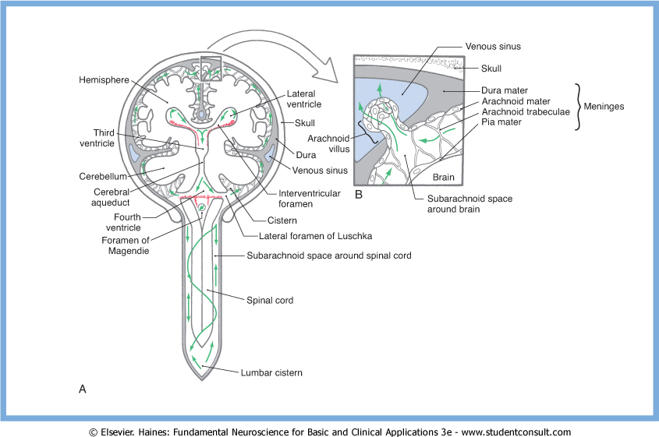
CSF
CSF reaches the arachnoid villi that extend into the superior sagittal sinus and into the venous lakes lateral to the superior sagittal sinus
At this point CSF enters the venous circulation through two routes. A limited amount passes between the cells making up the arachnoid villus, whereas most is transported through these cells in membrane-bound vesicles
About 330 to 380 mL of CSF enters the venous circulation per day, and about 120 mL is present in ventricles and subarachnoid space at any given time.

Slide 46
Hydocephalus
  Variants

Slide 47
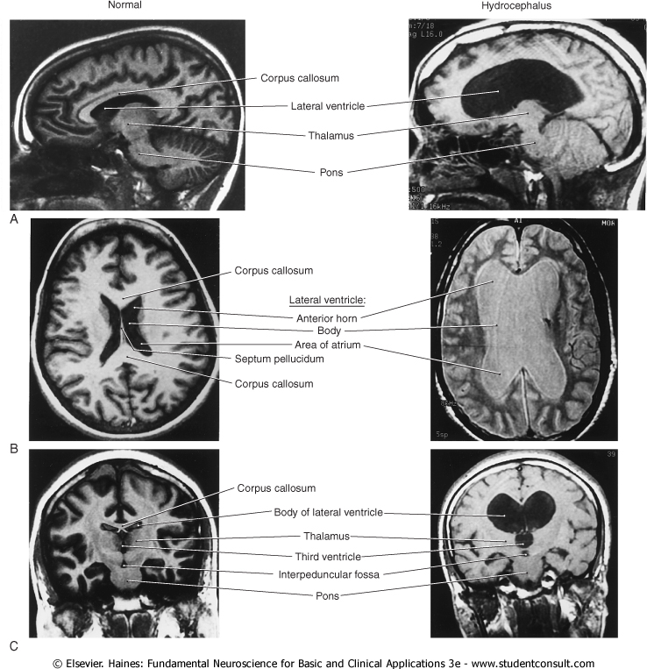
BLOCKAGE OF CSF MOVEMENT OR A FAILURE OF THE ABSORPTION MECHANISM WILL RESULT IN HYDROCEPHALUS,CHARACTERIZED BY AN INCREASE IN CSF VOLUME, ENLARGEMENT OF ONE OR MORE OF THE VENTRICLES, AND, USUALLY, AN INCREASE IN CSF PRESSURE

Slide 48
OBSTRUCTIVE HYDROCEPHALUS MAY RESULT FROM AN OBSTRUCTION SOMEWHERE WITHIN THE VENTRICULAR SYSTEM OR WITHIN THE SUBARACHNOID SPACE.

Slide 49
AQUEDUCTAL STENOSIS
Aqueductal stenosis may be caused by a tumor in the immediate vicinity of the midbrain (as in pineoblastoma or meningioma) that compresses the brain and occludes the cerebral aqueduct.
It may also be occluded by the cellular debris seen following intraventricular hemorrhage, by bacterial or fungal infections, or by ependymal proliferation due to viral infections of the CNS (especially mumps).
One major sequela of aqueductal blockade is enlargement of the third and both lateral ventricles (triventricular hydrocephalus ).
Unilateral obstruction of one interventricular foramen, by a colloid cyst in one interventricular foramen, results in enlargement of the lateral ventricle on that side.
Obstruction of the exit channels of the fourth ventricle, the foramina of Magendie and Luschka, will result in enlargement of all parts of the ventricular system.

Slide 50
COMMUNICATING HYDROCEPHALUS
In communicating hydrocephalus, the flow of CSF through the ventricular system and into the subarachnoid space is not impaired.
Movement of CSF through the subarachnoid space and into the venous system is partially or totally blocked.
Overproduction of CSF in patients with papilloma of the choroid plexus may also be a factor.
In both of these situations there is an enlargement of all parts of the ventricular system.

Slide 51
COMMUNICATING HYDROCEPHALUS
This block may be caused by a congenital absence (agenesis) of the arachnoid villi.
the villi may be partially blocked by red blood cells subsequent to a subarachnoid hemorrhage.
An exceedingly high level of protein in the CSF (above 500 mg/dL), as seen in patients with CNS tumors or inflammation, may also contribute to communicating hydrocephalus.
Other causes of communicating hydrocephalus include the interruption of CSF movement through the subarachnoid space caused by either subarachnoid hemorrhage or a major CNS infection, such as leptomeningitis, and the subsequent inflammatory response.

Slide 52
HYDROCEPHALUS EX VACUO
Hydrocephalus ex Vacuo is not a true hydrocephalus but rather a generalized atrophy of the brain resulting in ventricles that are relatively larger owing to the loss of white matter.
There is no increase in intracranial pressure, there are no neurologic deficits other than those that may be related to brain atrophy, and treatment is not indicated.
Ex vacuo changes may also refer to atrophy with a change in ventricular size that may follow, by several years, an event such as a stroke.

Slide 53
PSEUDOTUMOR CEREBRI
Idiopathic intracranial hypertension is most commonly seen in obese women of child-bearing age and in persons with chronic renal failure
It is possibly related to vitamin A toxicity.
There is an increase in intracranial pressure (>25 cm H2O), with little evidence of pressure increase on CT or magnetic resonance imaging studies,
Patients usually experience headache and a variety of visual deficits up to blindness due to papilledema .
Treatment includes a program of weight loss, medication, and, if needed, shunting (lumboperitoneal) or surgical fenestration

Slide 54
NORMAL PRESSURE HYDROCEPHALUS
Misnomer since CSF pressure is elevated episodically when measured over time (pressure may wax and wane)
Affects usually elderly patients.
In most cases the cause is unknown.
Patients with normal-pressure hydrocephalus experience a diagnostic triad consisting of urinary problems (frequency, urgency, or incontinence), impaired gait, and dementia.
Treatment is a shunting procedure to reduce CSF pressure and volume. In some cases there is general clinical improvement with lessening of all symptoms including those related to mental status.

Slide 55
The greatest pleasure in life is LOVE
(Anonymus)

Slide 56
THANK YOU

